Slide 1

CSC334 - Parallel & Distributed Computing
Chapter 2: Architectures
Mr. Aoun Haider, Ms. Muntaha Amjad

Slide 2
Architectures
Architectural styles
Architectural styles
Basic idea
A style is formulated in terms of
(replaceable) components with well-defined interfaces
the way that components are connected to each other
the data exchanged between components
how these components and connectors are jointly configured into a system.
Connector
A mechanism that mediates communication, coordination, or cooperation among components. Example: facilities for (remote) procedure call, messaging, or streaming.

Slide 3
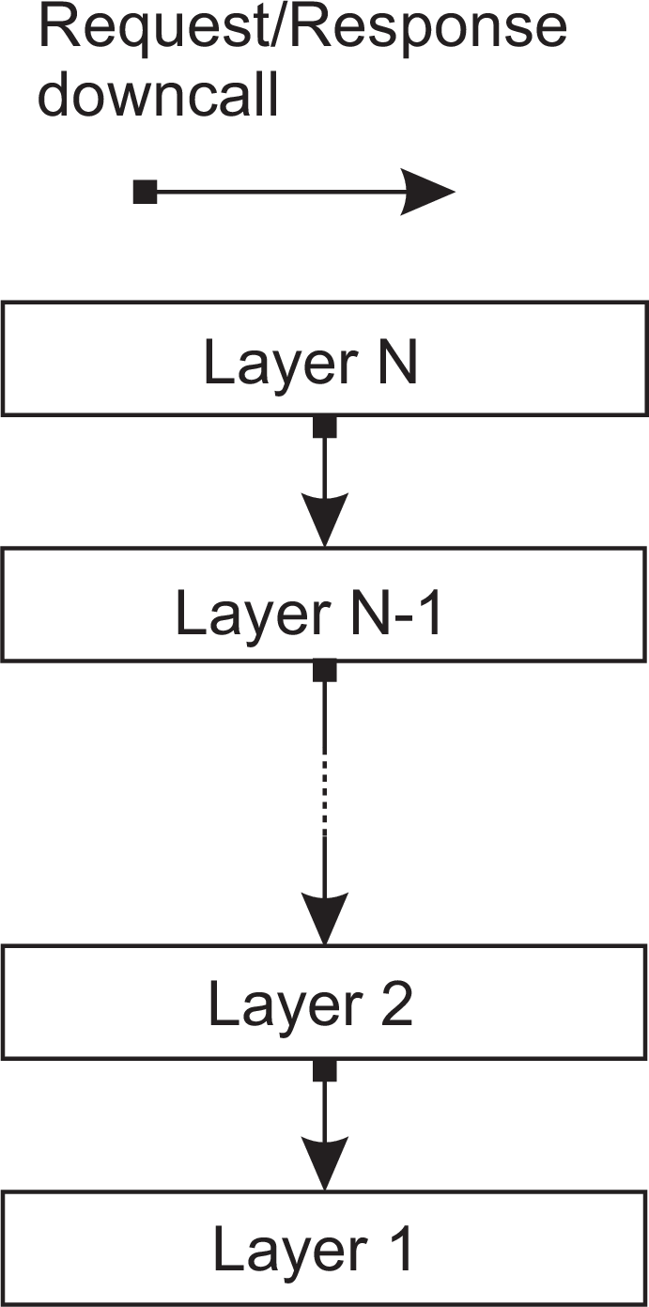
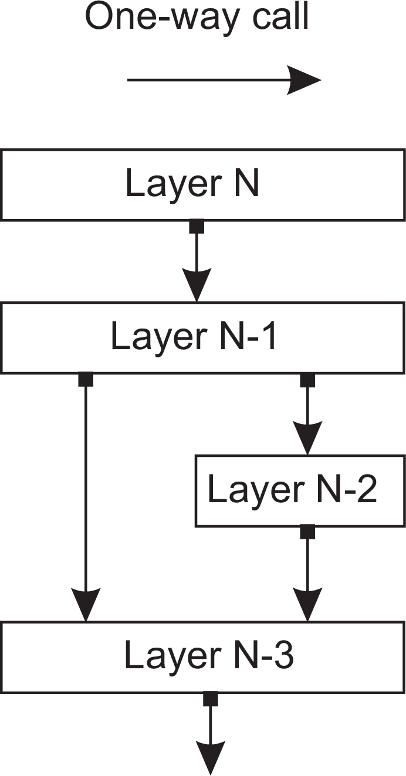
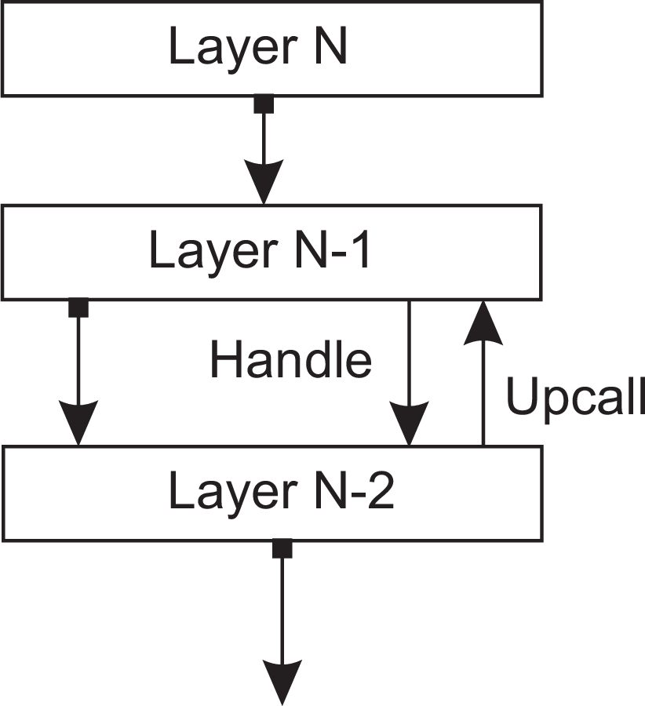
Architectures
Architectural styles
Layered architecture
Different layered organizations
(a)
(b)
(c)
Layered architectures

Slide 4
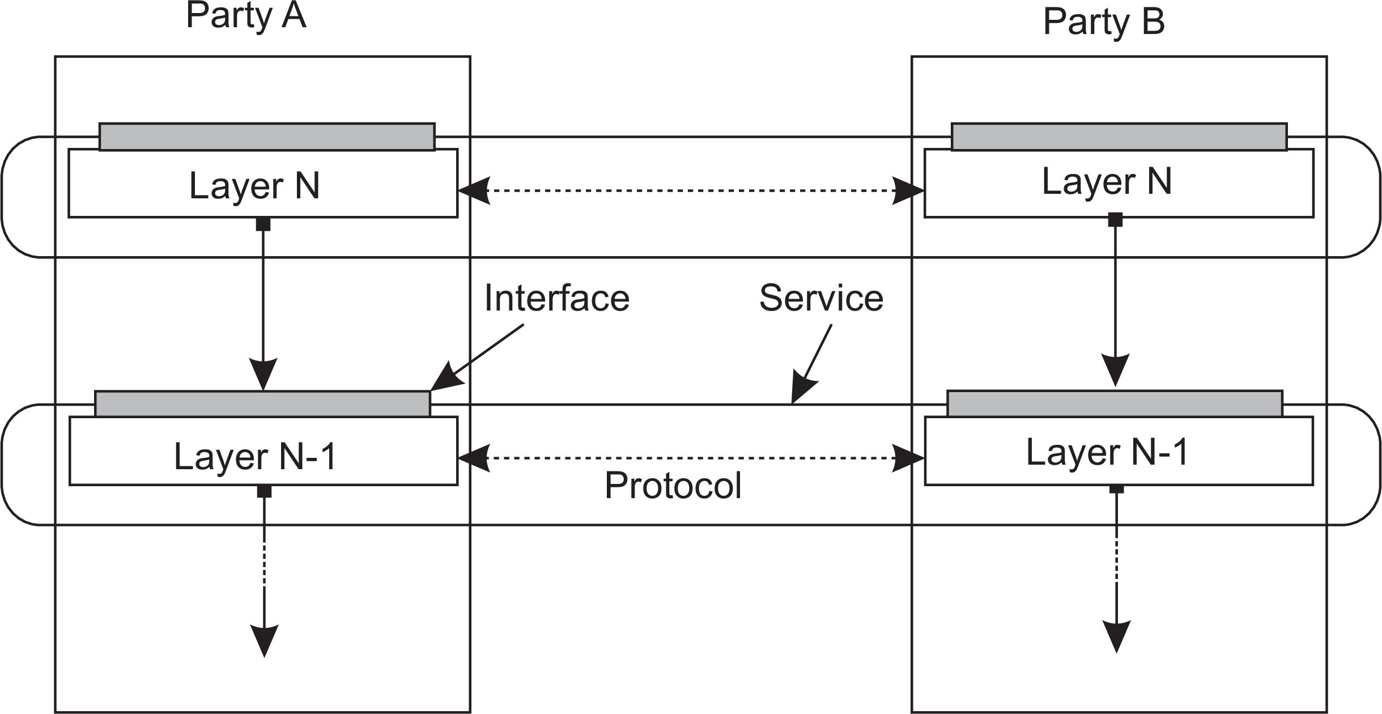
Architectures
Architectural styles
Example: communication protocols
Protocol, service, interface
Layered architectures

Slide 5
Architectures
Architectural styles
Two-party communication
Server
1 from socket import *
2
3 s = socket(AF_INET, SOCK_STREAM)
4 (conn, addr) = s.accept() # returns new socket and addr. client
5 while True: # forever
6
7
8
9
data = conn.recv(1024) # receive data from client
if not data: break # stop if client stopped
msg = data.decode()+"*" # process the incoming data into a response
conn.send(msg.encode()) # return the response
10 conn.close() # close the connection
Client
1 from socket import *
2
3 s = socket(AF_INET, SOCK_STREAM)
4 s.connect((HOST, PORT)) # connect to server (block until accepted)
5 msg = "Hello World" # compose a message
6 s.send(msg.encode()) # send the message
7 data = s.recv(1024) # receive the response
8 print(data.decode()) # print the result
9 s.close() # close the connection
Layered architectures

Slide 6
Application Layering
Architectures Architectural styles
Traditional three-layered view
Application-interface layer contains units for interfacing to users or external applications
Processing layer contains the functions of an application, i.e., without specific data
Data layer contains the data that a client wants to manipulate through the application components
Layered architectures

Slide 7
Application Layering
Architectures Architectural styles
Traditional three-layered view
Application-interface layer contains units for interfacing to users or external applications
Processing layer contains the functions of an application, i.e., without specific data
Data layer contains the data that a client wants to manipulate through the application components
Observation
This layering is found in many distributed information systems, using traditional database technology and accompanying applications.
Layered architectures

Slide 8
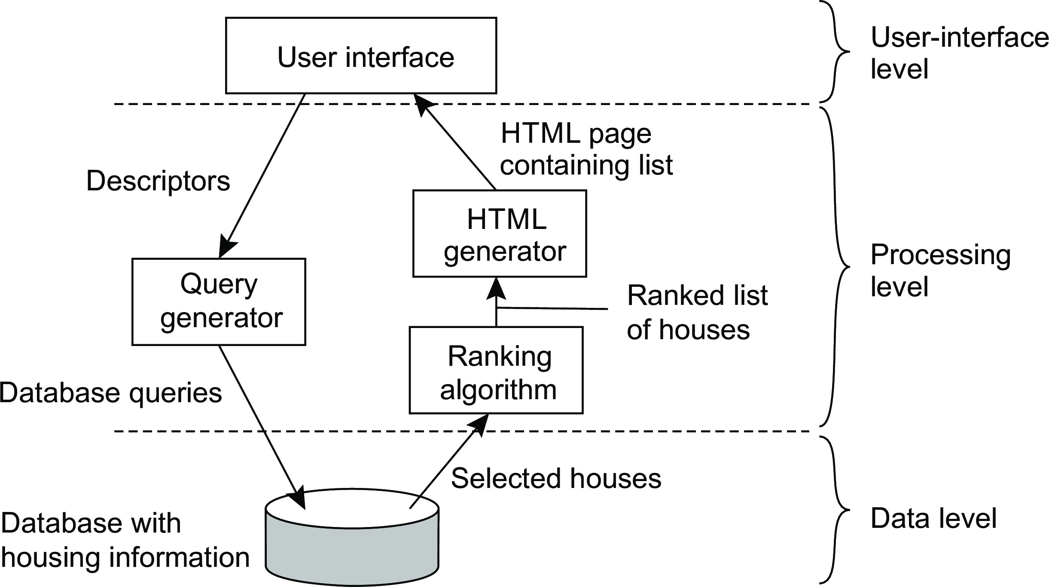
Architectures
Architectural styles
Application Layering
Example: a simple search engine
Consider example of information retrieval system (search engine) where we provide the search query in plain text which is converted to database query and further processed and result returned by database, which contains list of results against our search and represented in html document format by using ranking algorithms. Each layer is performing different tasks. User is manipulating data using application (interface) layer which further propagates to processing and data layer. We can divide our application into as many layers we want depending upon the problem domain.
Layered architectures

Slide 9
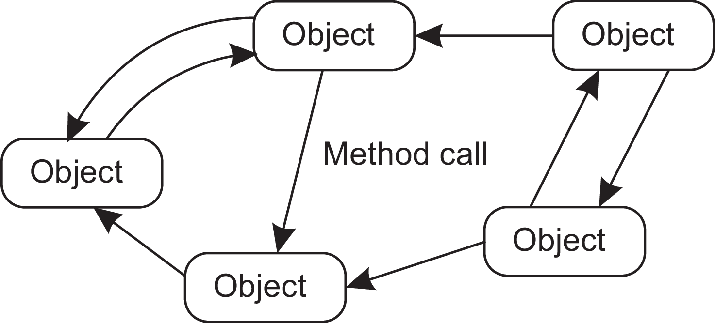
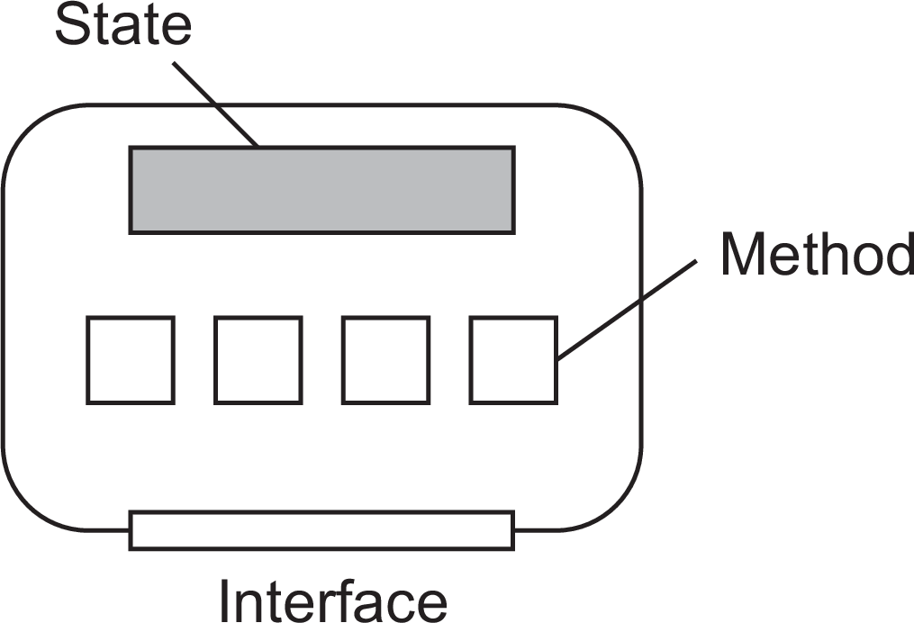
Object-based style
Architectures Architectural styles
Essence
Components are objects, connected to each other through procedure calls. Objects may be placed on different machines; calls can thus execute across a network.
Encapsulation
Objects are said to encapsulate data and offer methods on that data without revealing the internal implementation.
Service-oriented architectures

Slide 10
RESTful architectures
Architectures Architectural styles
Essence
View a distributed system as a collection of resources, individually managed by components. Resources may be added, removed, retrieved, and modified by (remote) applications.
Resources are identified through a single naming scheme
All services offer the same interface
Messages sent to or from a service are fully self-described
After executing an operation at a service, that component forgets everything about the caller
Basic operations
Operation | Description
PUT | Create a new resource
GET | Retrieve the state of a resource in some representation
DELETE | Delete a resource
POST | Modify a resource by transferring a new state
Service-oriented architectures

Slide 11
Example: Amazon’s Simple Storage Service
Architectures Architectural styles
Essence
Objects (i.e., files) are placed into buckets (i.e., directories). Buckets cannot be placed into buckets. Operations on ObjectName in bucket BucketName require the following identifier:
http://BucketName.s3.amazonaws.com/ObjectName
Typical operations
All operations are carried out by sending HTTP requests:
Create a bucket/object: PUT, along with the URI
Listing objects: GET on a bucket name
Reading an object: GET on a full URI
Service-oriented architectures

Slide 12
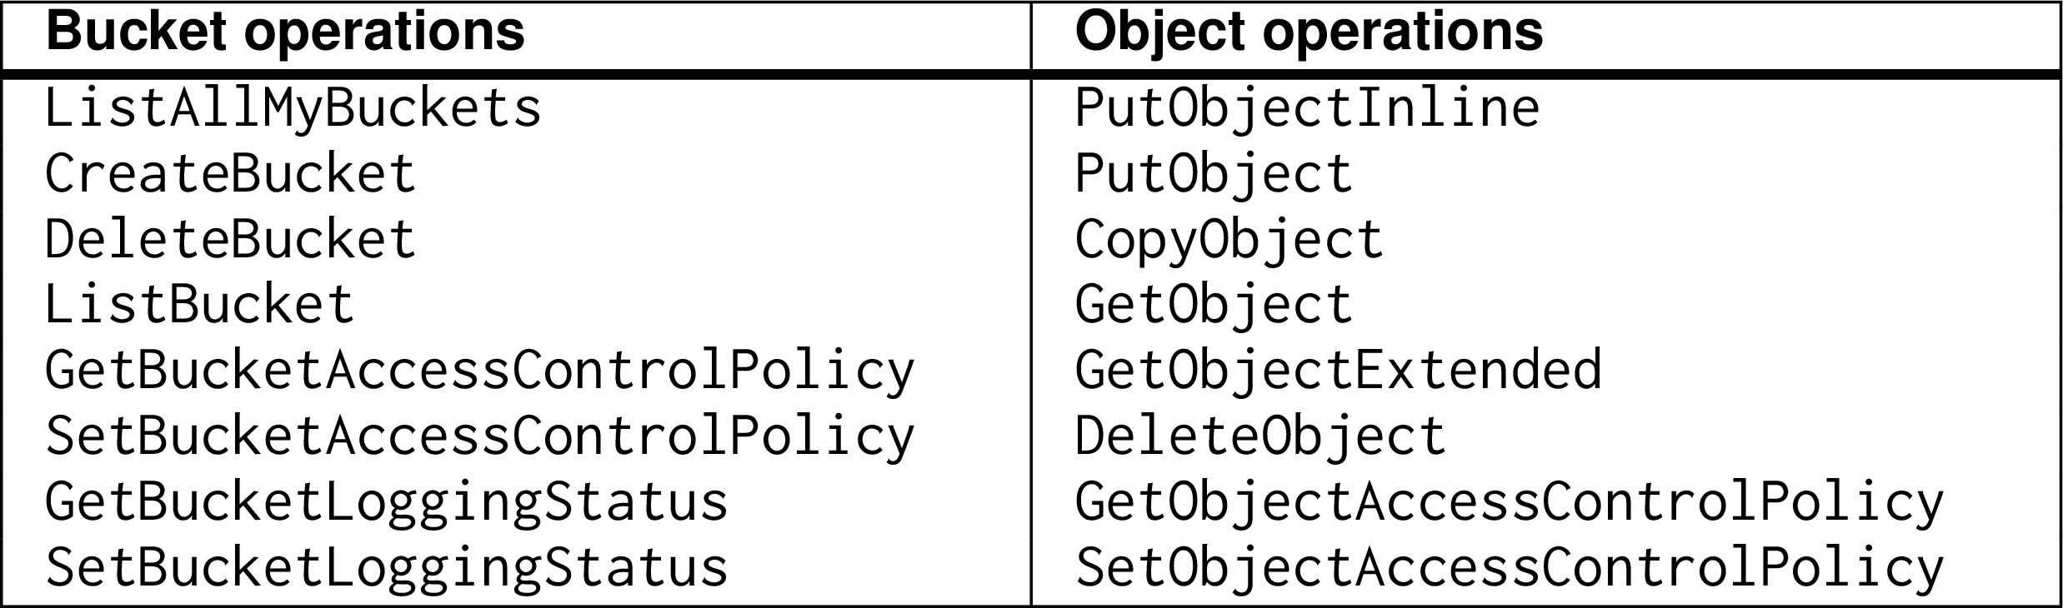
On interfaces
Architectures Architectural styles
Issue
Many people like RESTful approaches because the interface to a service is so simple. The catch is that much needs to be done in the parameter space.
Amazon S3 SOAP interface
Service-oriented architectures

Slide 13
On interfaces
Architectures Architectural styles
Simplifications
Assume an interface bucket offering an operation create, requiring an input string such as mybucket, for creating a bucket “mybucket.”
Service-oriented architectures

Slide 14
On interfaces
Architectures Architectural styles
Simplifications
Assume an interface bucket offering an operation create, requiring an input string such as mybucket, for creating a bucket “mybucket.”
SOAP
import bucket bucket.create("mybucket")
Service-oriented architectures

Slide 15
On interfaces
Architectures Architectural styles
Simplifications
Assume an interface bucket offering an operation create, requiring an input string such as mybucket, for creating a bucket “mybucket.”
SOAP
import bucket bucket.create("mybucket")
RESTful
PUT "https://mybucket.s3.amazonsws.com/"
Service-oriented architectures

Slide 16
On interfaces
Architectures Architectural styles
Simplifications
Assume an interface bucket offering an operation create, requiring an input string such as mybucket, for creating a bucket “mybucket.”
SOAP
import bucket bucket.create("mybucket")
RESTful
PUT "https://mybucket.s3.amazonsws.com/"
Conclusions
Are there any to draw?
Service-oriented architectures

Slide 17
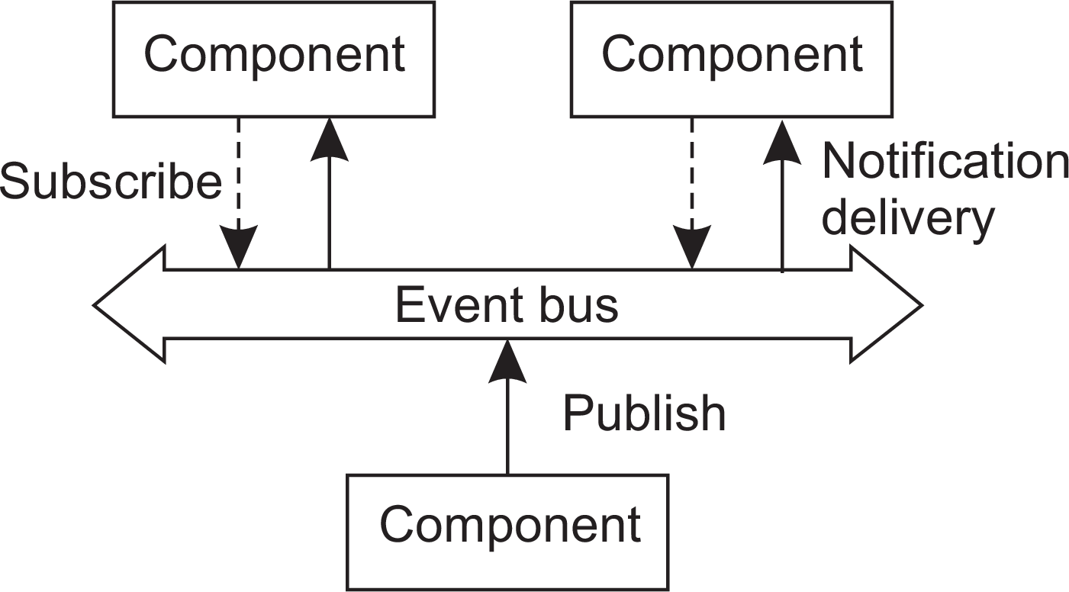
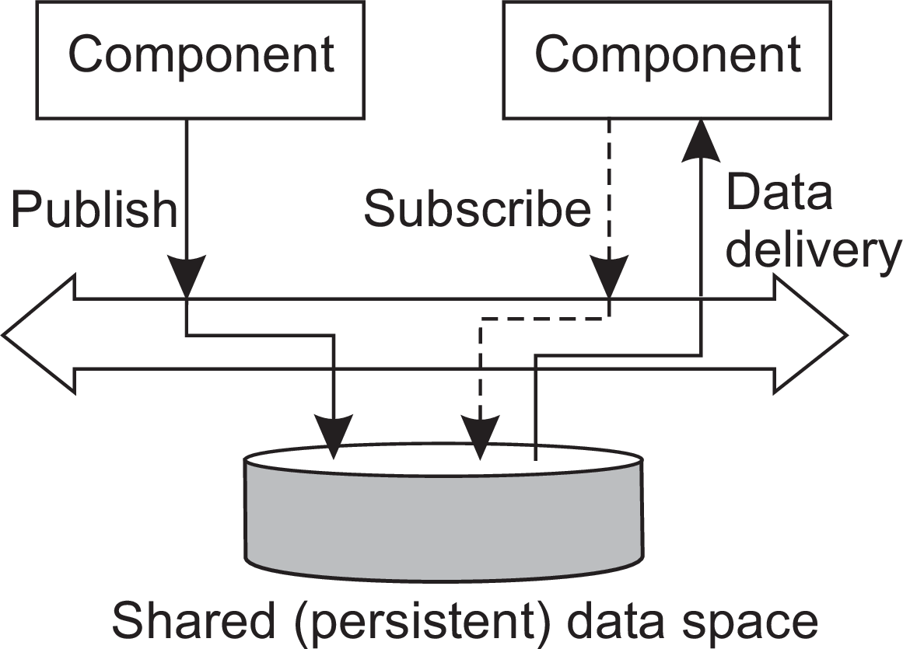
Architectures
Architectural styles
Coordination
Temporal and referential coupling
 | Temporally coupled | Temporally coupled
Referentially coupled | Direct | Mailbox
Referentially decoupled | Event-based | Shared data space
Event-based and Shared data space
Publish-subscribe architectures

Slide 18
Architectures
Architectural styles
Coordination
Temporal and referential coupling
 | Temporally coupled | Temporally coupled
Referentially coupled | Direct | Mailbox
Referentially decoupled | Event-based | Shared data space
Referentially coupled: Components knows about identity of each other
Referentially decoupled: Components does not know about identity of each other
Temporally coupled: Both components must be available while coordination
Temporally coupled: Both components may be available while coordination
Example:
Direct: Phone call (both sides must be present at same time)
Mailbox: Email messages (receiver can be offline)
Event based: Sender publishes the event and subscriber consumes (notifications)
Shared data space: Both send and receive data from shared address space without knowing each other, any time
Publish-subscribe architectures

Slide 19
Architectures
Architectural styles
Example: Linda tuple space
Three simple operations
in(t): remove a tuple matching template t
rd(t): obtain copy of a tuple matching template t
out(t): add tuple t to the tuple space
More details
Calling out(t) twice in a row, leads to storing two copies of tuple t ⇒ a tuple space is modeled as a multiset.
Both in and rd are blocking operations: the caller will be blocked until a matching tuple is found, or has become available.
Publish-subscribe architectures

Slide 20
Architectures
Architectural styles
Example: Linda tuple space
1 import linda
2 linda.connect()
3
4 blog = linda.TupleSpace()
5 linda.universe._out(("MicroBlog",blog))
Bob:
6
7 blog = linda.universe._rd(("MicroBlog",linda.TupleSpace))[1]
8
9 blog._out(("bob","distsys","I am studying chap 2"))
10 blog._out(("bob","distsys","The linda example’s pretty simple"))
11 blog._out(("bob","gtcn","Cool book!"))
1 import linda
2 linda.connect()
3
4 blog = linda.universe._rd(("MicroBlog",linda.TupleSpace))[1]
5
6 blog._out(("alice","gtcn","This graph theory stuff is not easy"))
7 blog._out(("alice","distsys","I like systems more than graphs"))
Alice:
1 import linda
2 linda.connect()
3
4 blog = linda.universe._rd(("MicroBlog",linda.TupleSpace))[1]
5
6 t1 = blog._rd(("bob","distsys",str))
7 t2 = blog._rd(("alice","gtcn",str))
8 t3 = blog._rd(("bob","gtcn",str))
9
10 print t1
11 print t2
12 print t3
Chuck:
Publish-subscribe architectures

Slide 21
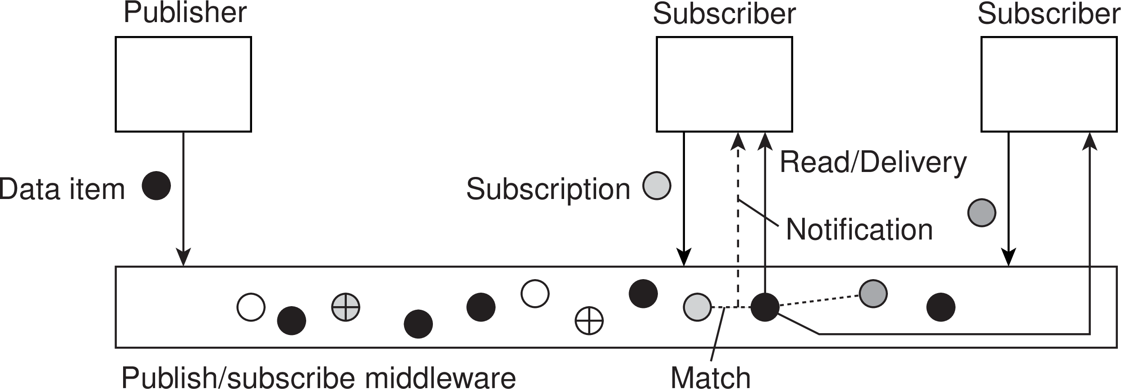
Architectures
Architectural styles
Publish and subscribe
Issue: how to match events?
Assume events are described by (attribute,value) pairs
topic-based subscription: specify a “attribute = value” series
content-based subscription: specify a “attribute ∈ range” series
Observation
Content-based subscriptions may easily have serious scalability problems (why?)
Publish-subscribe architectures

Slide 22
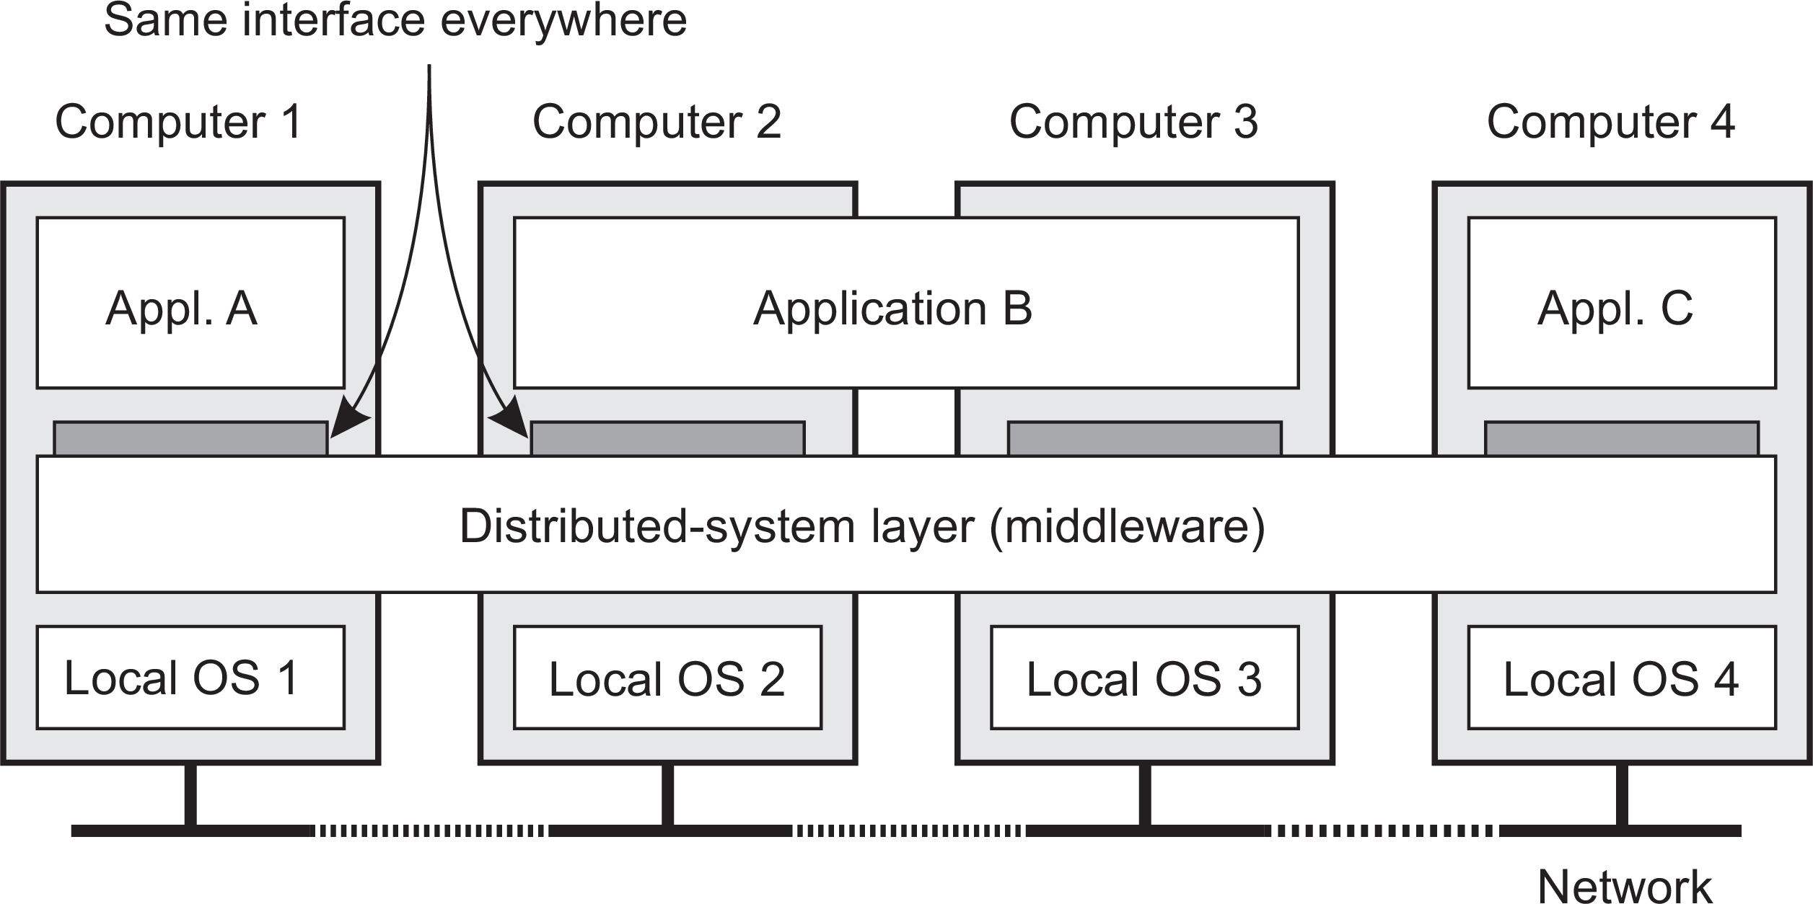
Architectures
Middleware and distributed systems
Middleware: the OS of distributed systems
What does it contain?
Commonly used components and functions that need not be implemented by applications separately.

Slide 23
Using legacy to build middleware
Architectures Middleware and distributed systems
Problem
The interfaces offered by a legacy component are most likely not suitable for all applications.
Solution
A wrapper or adapter offers an interface acceptable to a client application. Its functions are transformed into those available at the component.
Middleware organization

Slide 24
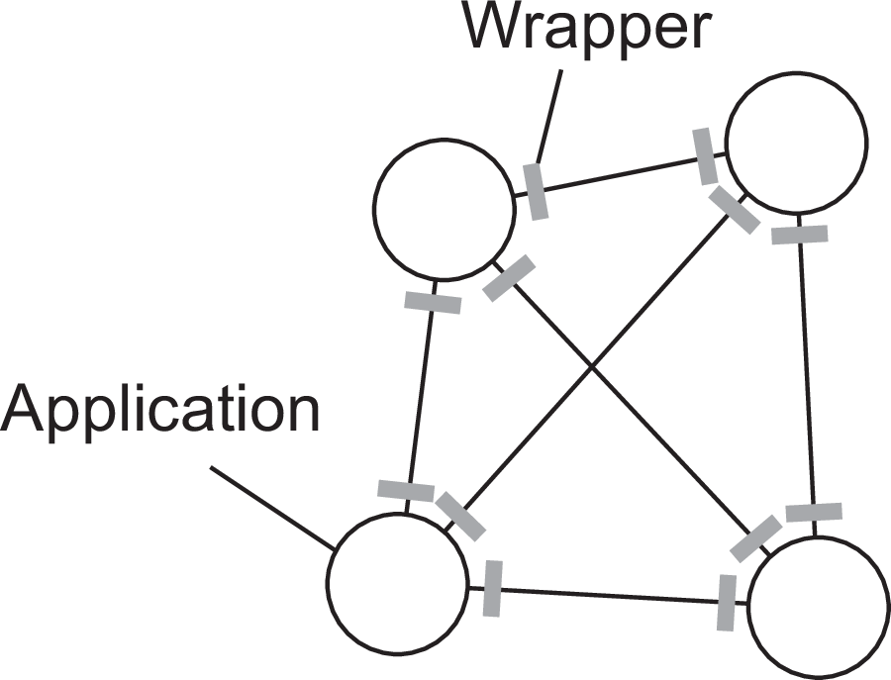
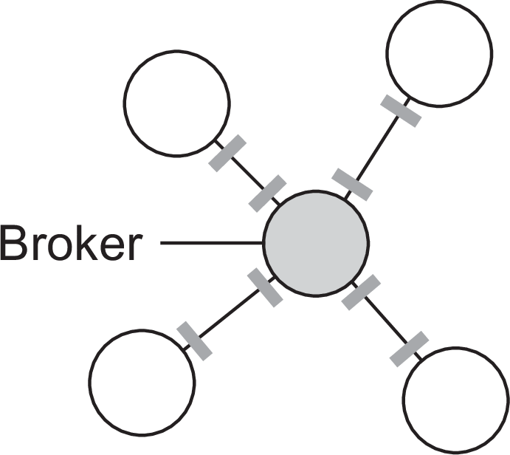
Architectures
Middleware and distributed systems
Organizing wrappers
Two solutions: 1-on-1 or through a broker
Complexity with N applications
1-on-1: requires N ×(N − 1) = O(N²) wrappers
broker: requires 2N = O(N) wrappers
Less # of wrappers are required if a broker( single interface for
applications for compatibility) is used.
Middleware organization

Slide 25
Developing adaptable middleware
Architectures Middleware and distributed systems
Problem
Middleware contains solutions that are good for most applications ⇒ you may want to adapt its behavior for specific applications.
Middleware organization

Slide 26
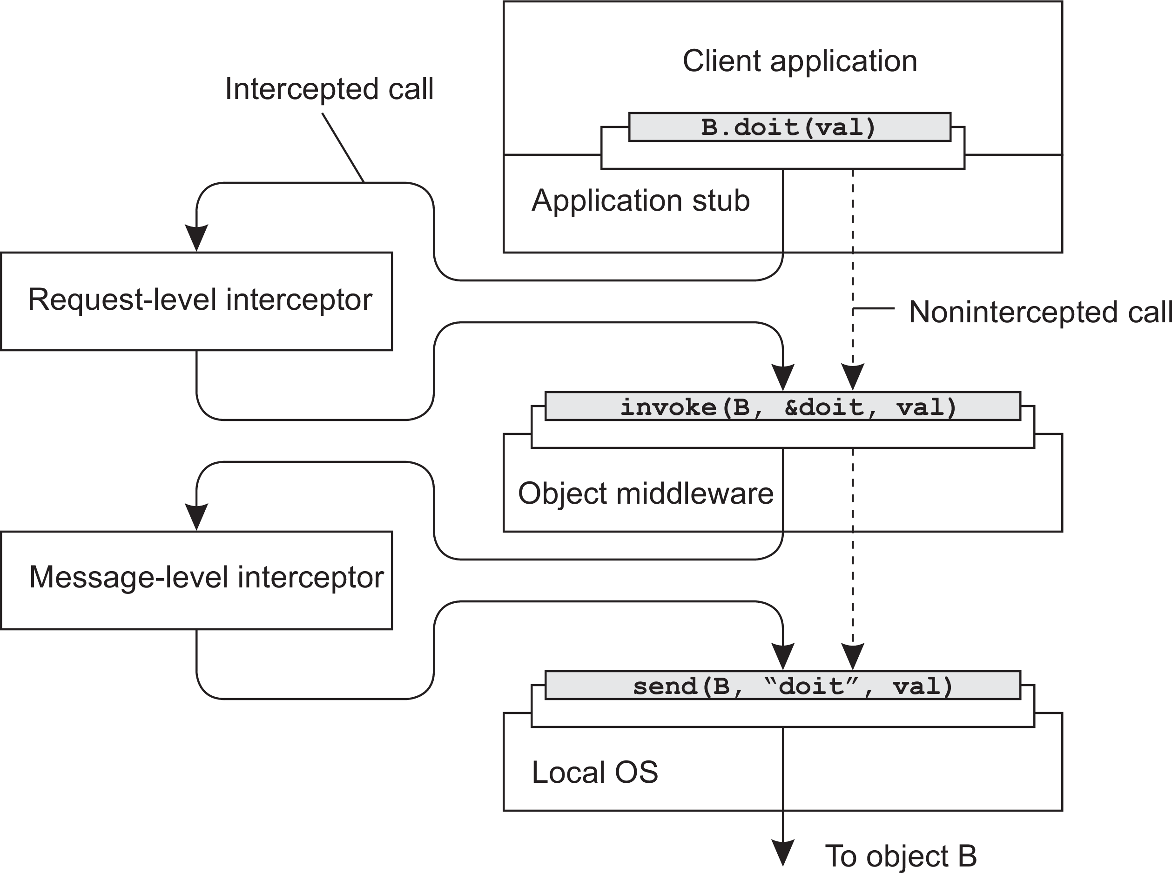
Architectures
Middleware and distributed systems
Intercept the usual flow of control
Middleware organization
Notes:
Application 1 wants to call method doit(val) on object B which is stored on Application 2 on another machine. Use object method invocation protocol to call method of other process using remote call with the help of interceptor at transport level.

Slide 27
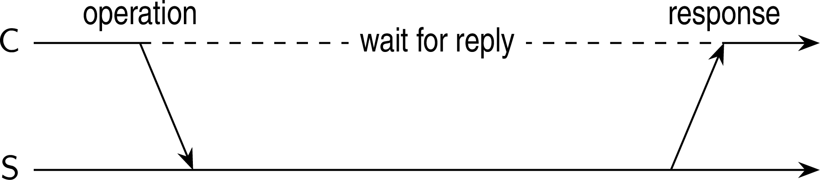
Architectures
Layered-system architectures
Centralized system architectures
Basic Client–Server Model
Characteristics:
There are processes offering services (servers)
There are processes that use services (clients)
Clients and servers can be on different machines
Clients follow request/reply model regarding using services
Simple client-server architecture

Slide 28
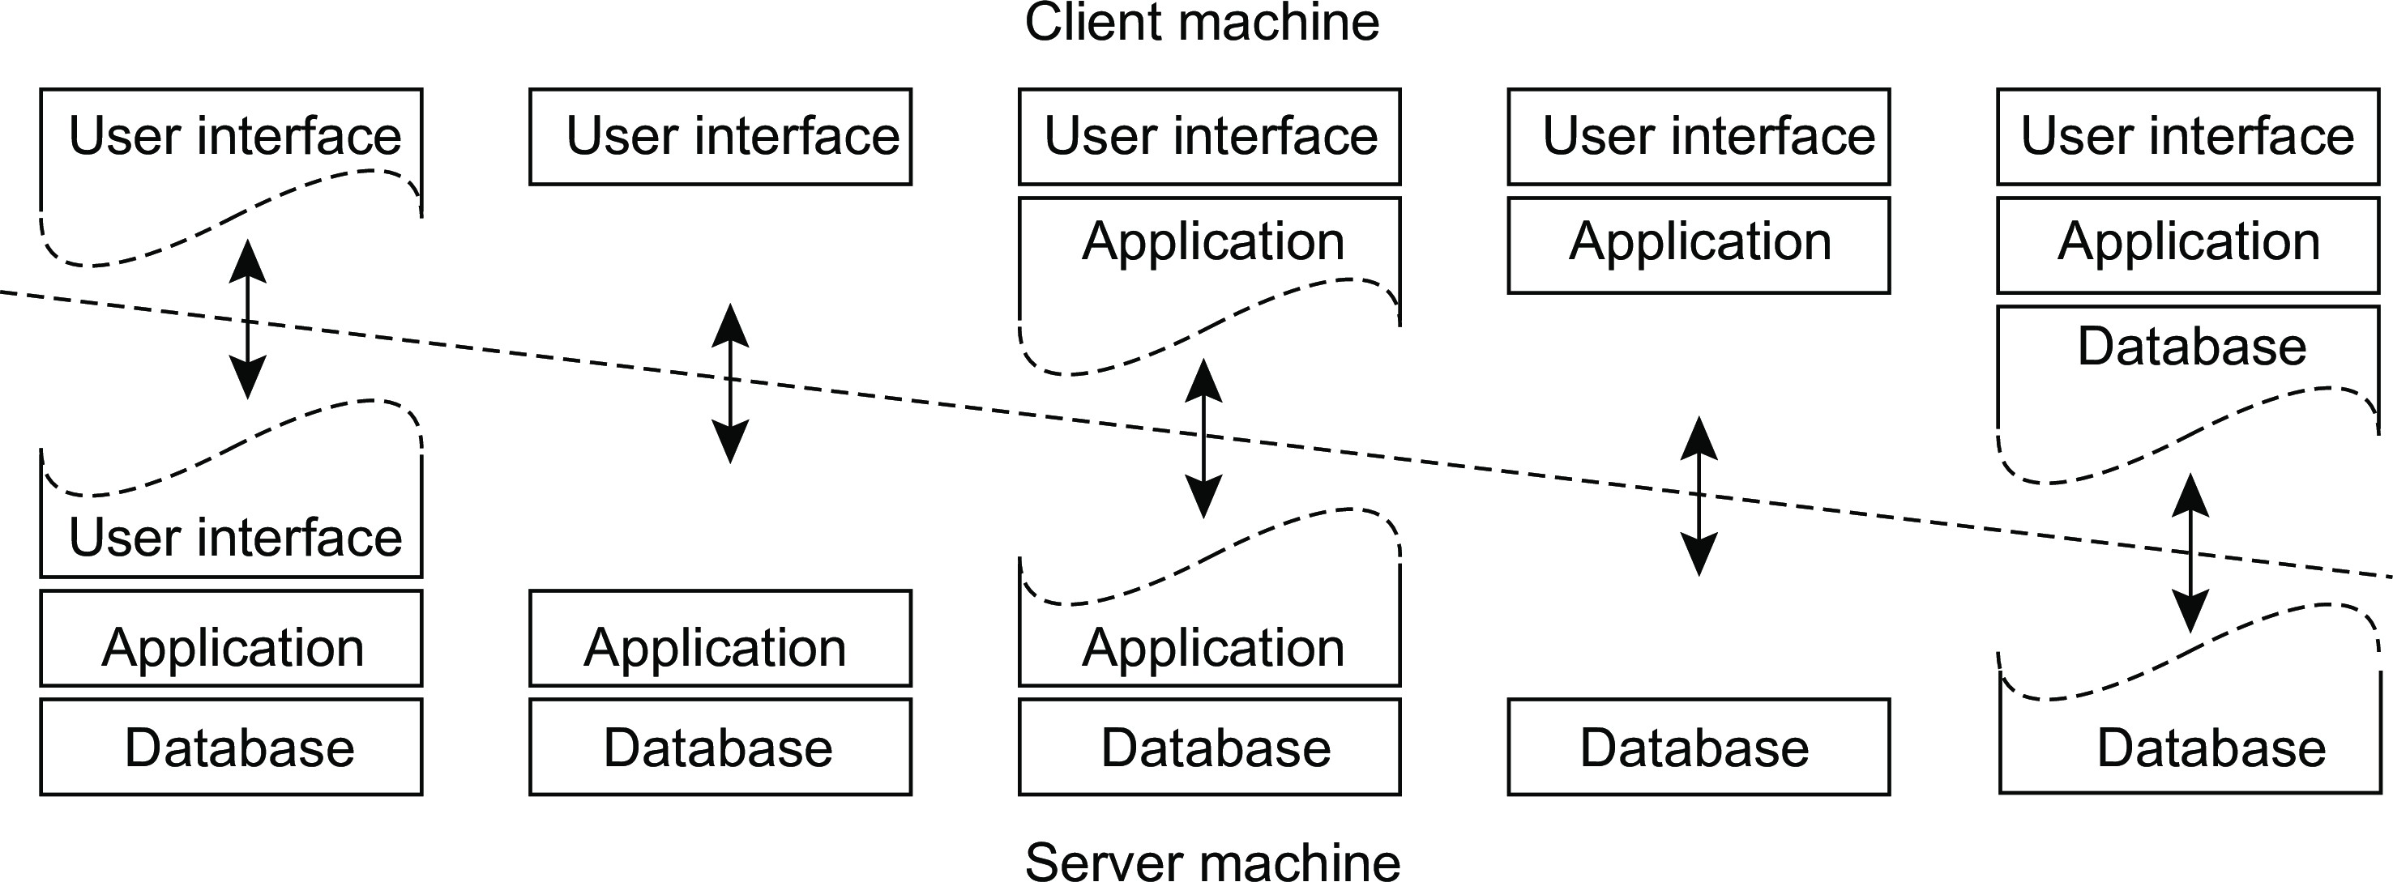
Architectures
Layered-system architectures
Multi-tiered centralized system architectures
Some traditional organizations
Single-tiered: dumb terminal/mainframe configuration
Two-tiered: client/single server configuration
Three-tiered: each layer on separate machine
Traditional two-tiered configurations
(a)
(b)
(c)
(d)
(e)
Multitiered Architectures
Notes:
Thin Client vs Fat Client (Cost vs Performance)

Slide 29
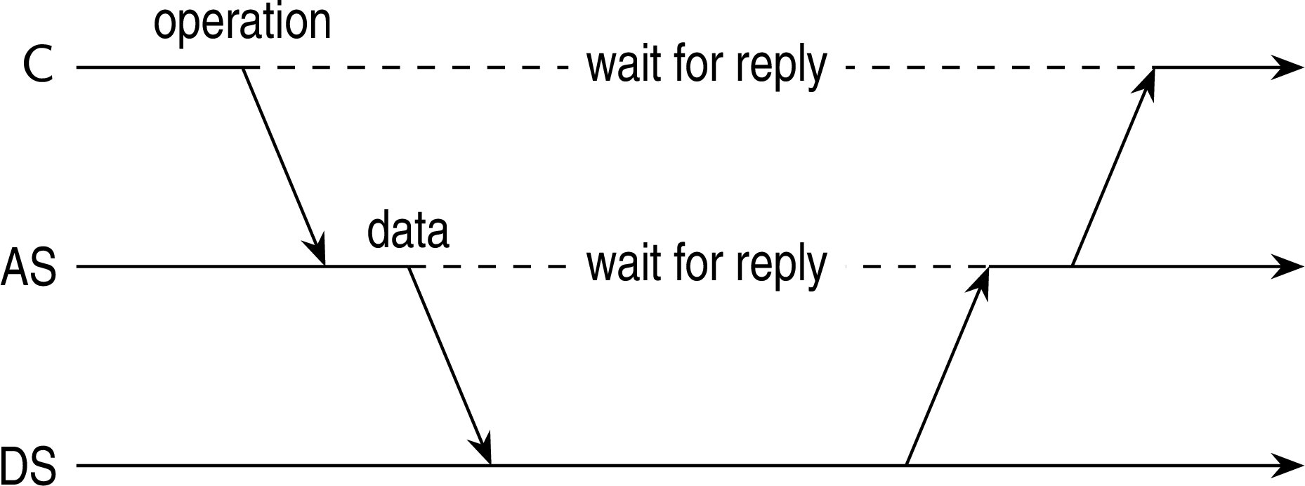
Architectures
Layered-system architectures
Being client and server at the same time
Three-tiered architecture
Multitiered Architectures

Slide 30
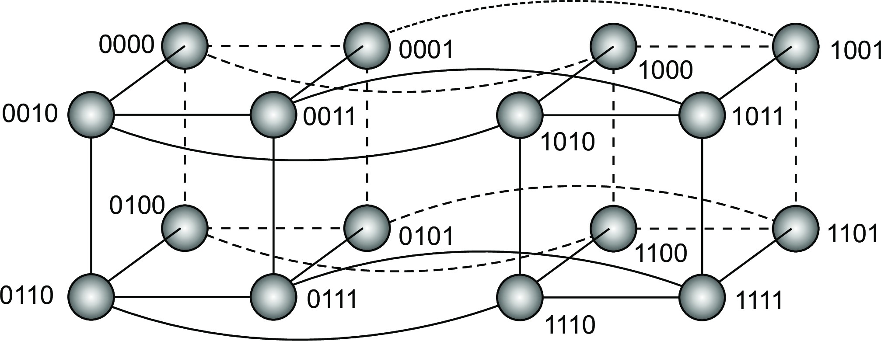
Structured P2P
Architectures Symmetrically distributed system architectures
Essence
Make use of a semantic-free index: each data item is uniquely associated with a key, in turn used as an index. Common practice: use a hash function
key(data item) = hash(data item’s value).
P2P system now responsible for storing (key,value) pairs.
Simple example: hypercube
Looking up d with key k ∈ {0, 1, 2,..., 2⁴ − 1} means routing request to node with identifier k .
Structured peer-to-peer systems
Notes:
Horizontal: Physical division across machines for the same task (e.g., multiple web servers for load sharing).
Vertical: Logical division into layers (e.g., UI, business logic, database), which can run on the same or different machines.
Each node acts as both client and server in P2P

Slide 31
Example: Chord
Architectures Symmetrically distributed system architectures
Principle
Nodes are logically organized in a ring. Each node has an m-bit identifier.
Each data item is hashed to an m-bit key.
Data item with key k is stored at node with smallest identifier id ≥ k , called the successor of key k .
The ring is extended with various shortcut links to other nodes.
Structured peer-to-peer systems

Slide 32
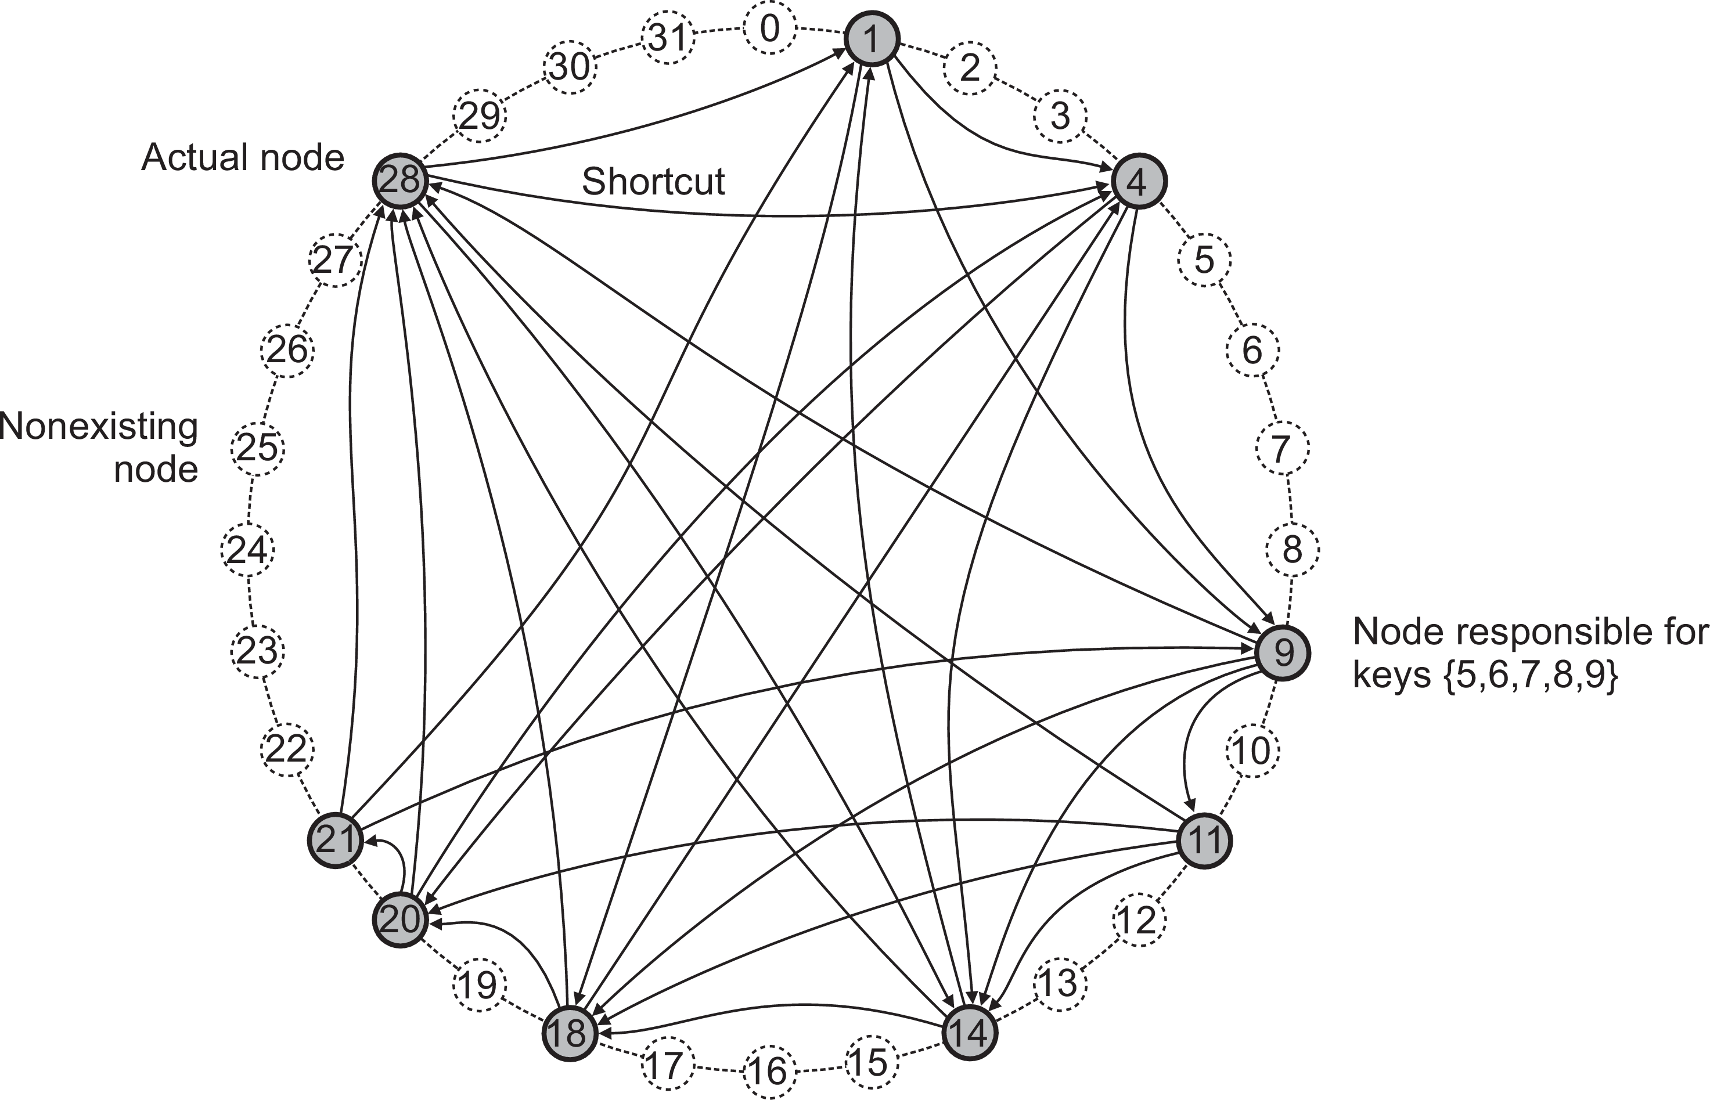
Architectures
Symmetrically distributed system architectures
Example: Chord
lookup(3)@9 : 28 → 1 → 4
Structured peer-to-peer systems

Slide 33
Unstructured P2P
Architectures Symmetrically distributed system architectures
Essence
Each node maintains an ad hoc list of neighbors. The resulting overlay resembles a random graph: an edge ⟨u, v ⟩ exists only with a certain probability P[⟨u, v ⟩].
Searching
Flooding: issuing node u passes request for d to all neighbors. Request is ignored when receiving node had seen it before. Otherwise, v searches locally for d (recursively). May be limited by a Time-To-Live: a maximum number of hops.
Random walk: issuing node u passes request for d to randomly chosen neighbor, v . If v does not have d , it forwards request to one of its randomly chosen neighbors, and so on.
Unstructured peer-to-peer systems

Slide 34
Flooding versus random walk
Architectures Symmetrically distributed system architectures
Model
Assume N nodes and that each data item is replicated across r randomly chosen nodes.
Random walk
P[k ] probability that item is found after k attempts:
P[k ] = ^{r} (1 − ^{r} )^{k −1}.
N N
S (“search size”) is expected number of nodes that need to be probed:
N N
r
S = ∑ k · P[k ] = ∑ k · _{N} (1 − _{N} ) ≈ N/r for 1 ≪ r ≤ N.
^{r} k −1
k =1
k =1
Unstructured peer-to-peer systems

Slide 35
Flooding versus random walk
Architectures Symmetrically distributed system architectures
Flooding
Flood to d randomly chosen neighbors
After k steps, some R(k ) = d · (d − 1)^{k −1} will have been reached (assuming k is small).
With fraction r/N nodes having data, if ^{r} · R(k ) ≥ 1, we will have found
N
the data item.
Comparison
If r/N = 0.001, then S ≈ 1000
With flooding and d = 10, k = 4, we contact 7290 nodes.
Random walks are more communication efficient, but might take longer before they find the result.
Unstructured peer-to-peer systems

Slide 36
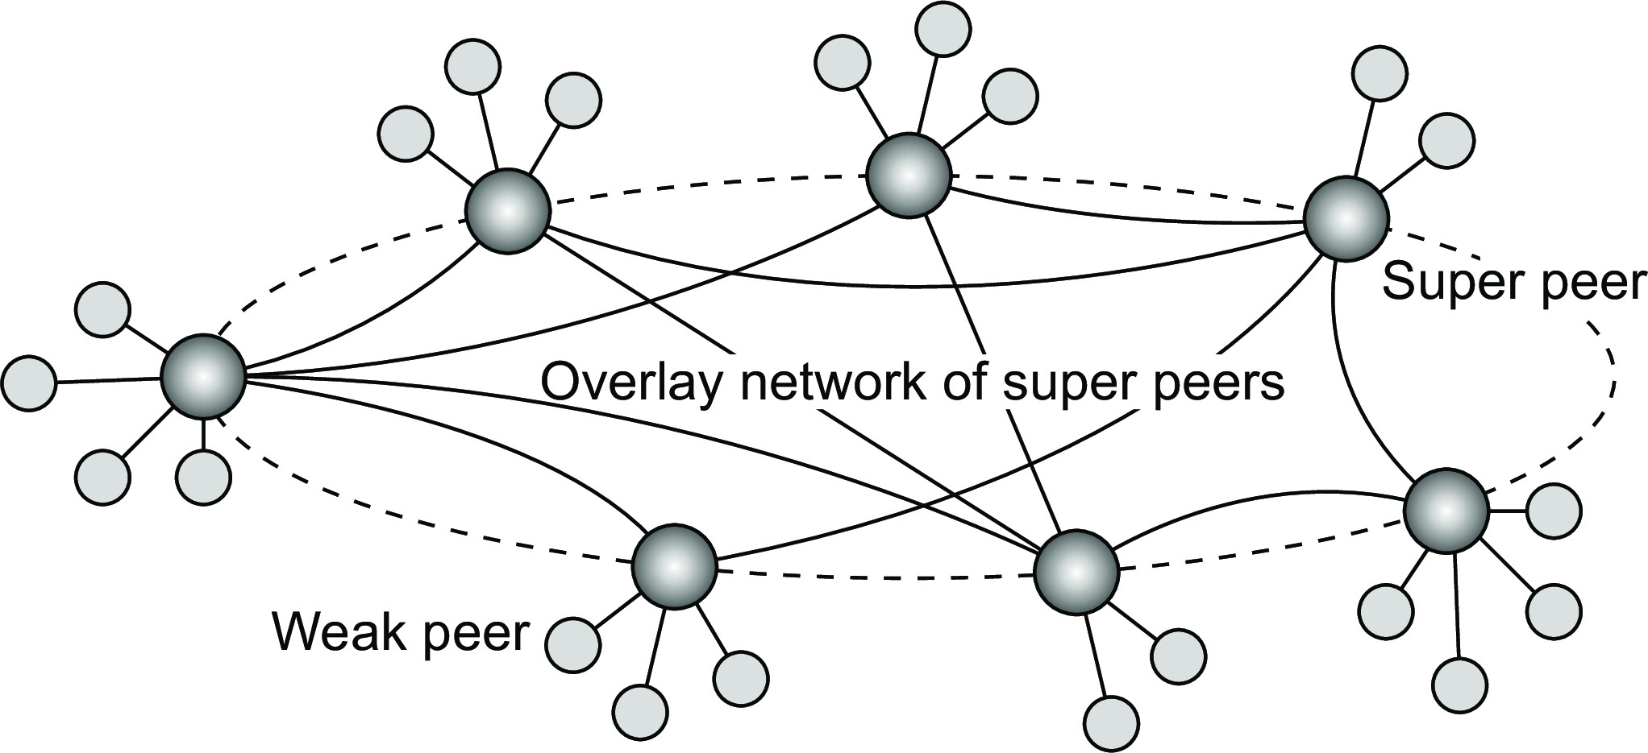
Super-peer networks
Architectures Symmetrically distributed system architectures
Essence
It is sometimes sensible to break the symmetry in pure peer-to-peer networks:
When searching in unstructured P2P systems, having index servers improves performance
Deciding where to store data can often be done more efficiently through brokers.
Hierarchically organized peer-to-peer networks
Notes:
Broker = Super-peer (Knows about list of peers or weak-peers)
Each weak peer will contact other with the help of strong peer by sending request to it which will further lookup and responsible for forwarding the request to direct destination weak peer or neighbor strong-peer who knows about the corresponding weak-peer and so on..

Slide 37
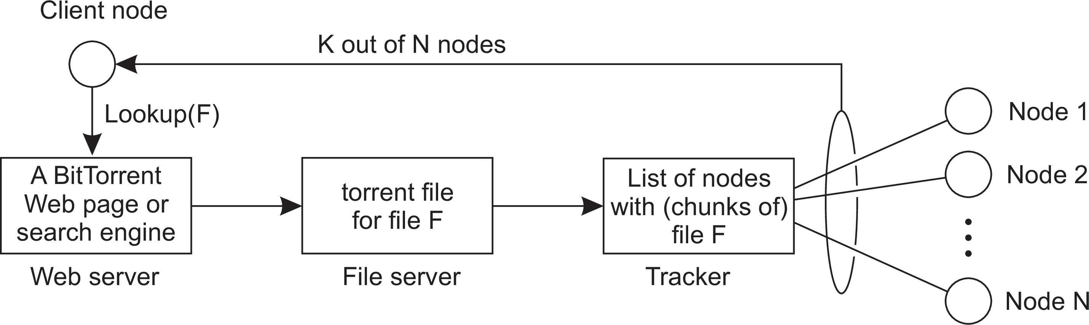
Collaboration: The BitTorrent case
Architectures Symmetrically distributed system architectures
Principle: search for a file F
Lookup file at a global directory ⇒ returns a torrent file
Torrent file contains reference to tracker: a server keeping an accurate account of active nodes that have (chunks of) F .
P can join swarm, get a chunk for free, and then trade a copy of that chunk for another one with a peer Q also in the swarm.
Example: BitTorrent

Slide 38
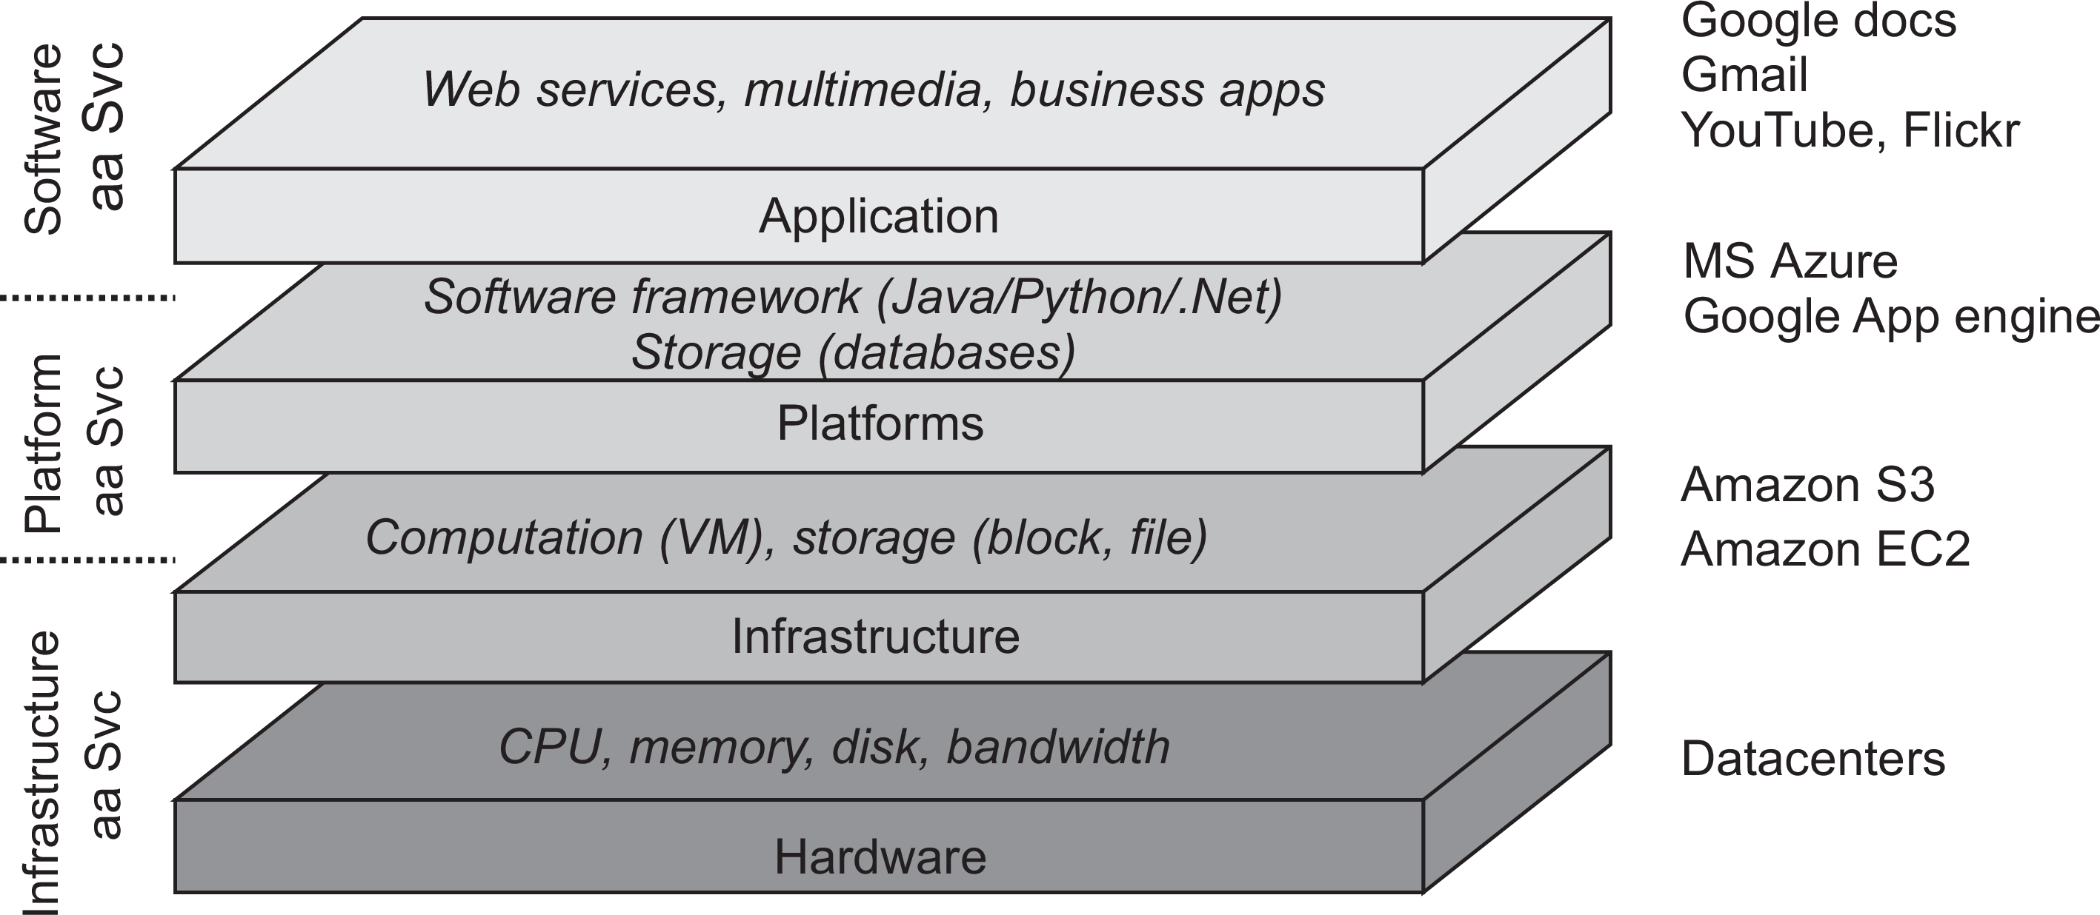
Architectures
Hybrid system architectures
Cloud computing
Cloud computing

Slide 39
Cloud computing
Architectures Hybrid system architectures
Make a distinction between four layers
Hardware: Processors, routers, power and cooling systems. Customers normally never get to see these.
Infrastructure: Deploys virtualization techniques. Evolves around allocating and managing virtual storage devices and virtual servers.
Platform: Provides higher-level abstractions for storage and such. Example: Amazon S3 storage system offers an API for (locally created) files to be organized and stored in so-called buckets.
Application: Actual applications, such as office suites (text processors, spreadsheet applications, presentation applications). Comparable to the suite of apps shipped with OSes.
Cloud computing

Slide 40
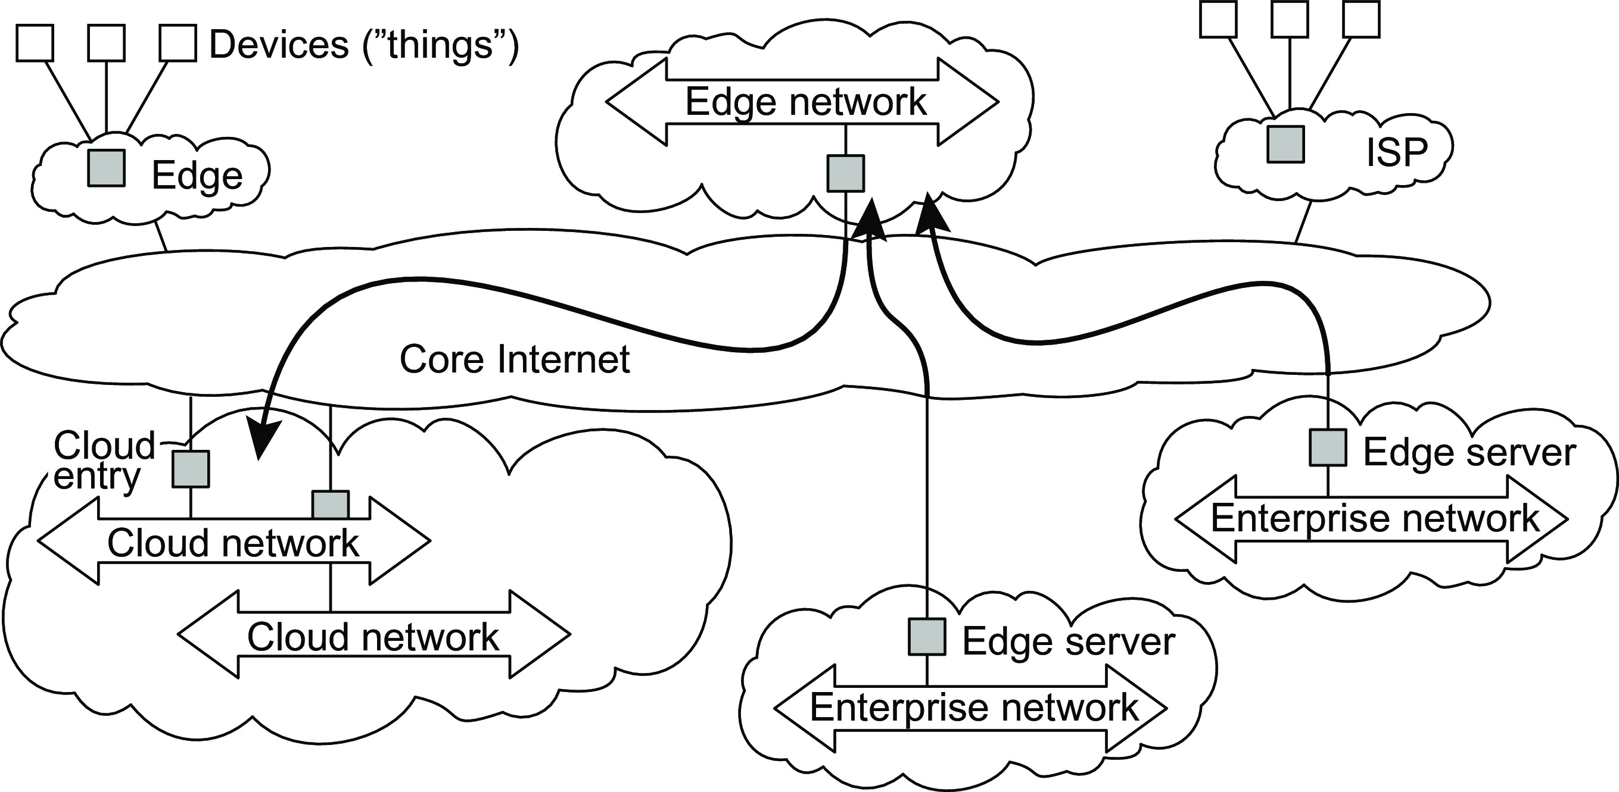
Edge-server architecture
Architectures Hybrid system architectures
Essence
Systems deployed on the Internet where servers are placed at the edge of the network: the boundary between enterprise networks and the actual Internet.
The edge-cloud architecture

Slide 41
Reasons for having an edge infrastructure
Architectures Hybrid system architectures
Commonly (and often misconceived) arguments
Latency and bandwidth: Especially important for certain real-time applications, such as augmented/virtual reality applications. Many people underestimate the latency and bandwidth to the cloud.
Reliability: The connection to the cloud is often assumed to be unreliable, which is often a false assumption. There may be critical situations in which extremely high connectivity guarantees are needed.
Security and privacy: The implicit assumption is often that when assets are nearby, they can be made better protected. Practice shows that this assumption is generally false. However, securely handling data operations in the cloud may be trickier than within your own organization.
The edge-cloud architecture

Slide 42
Edge orchestration
Architectures Hybrid system architectures
Managing resources at the edge may be trickier than in the cloud
Resource allocation: we need to guarantee the availability of the resources required to perform a service.
Service placement: we need to decide when and where to place a service. This is notably relevant for mobile applications.
Edge selection: we need to decide which edge infrastructure should be used when a service needs to be offered. The closest one may not be the best one.
Observation
There is still a lot of buzz about edge infrastructures and computing, yet whether all that buzz makes any sense remains to be seen.
The edge-cloud architecture

Slide 43
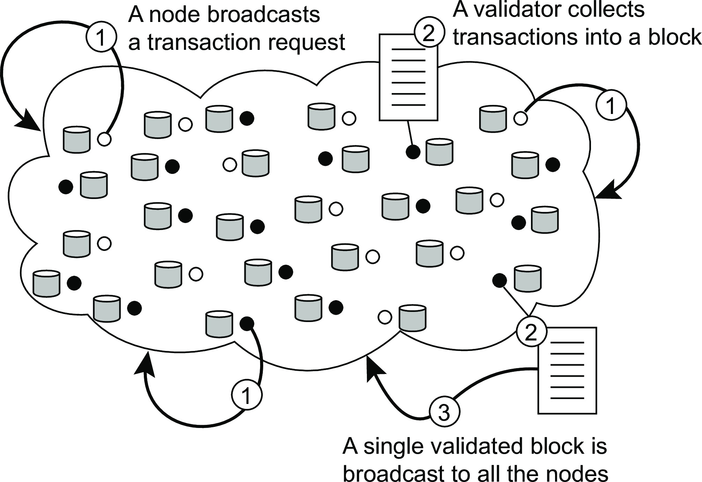
Architectures
Hybrid system architectures
Blockchains
Principle working of a blockchain system
Blockchain architectures

Slide 44
Architectures
Hybrid system architectures
Blockchains
Principle working of a blockchain system
Observations
Blocks are organized into an unforgeable append-only chain
Each block in the blockchain is immutable ⇒ massive replication
The real snag lies in who is allowed to append a block to a chain
Blockchain architectures

Slide 45
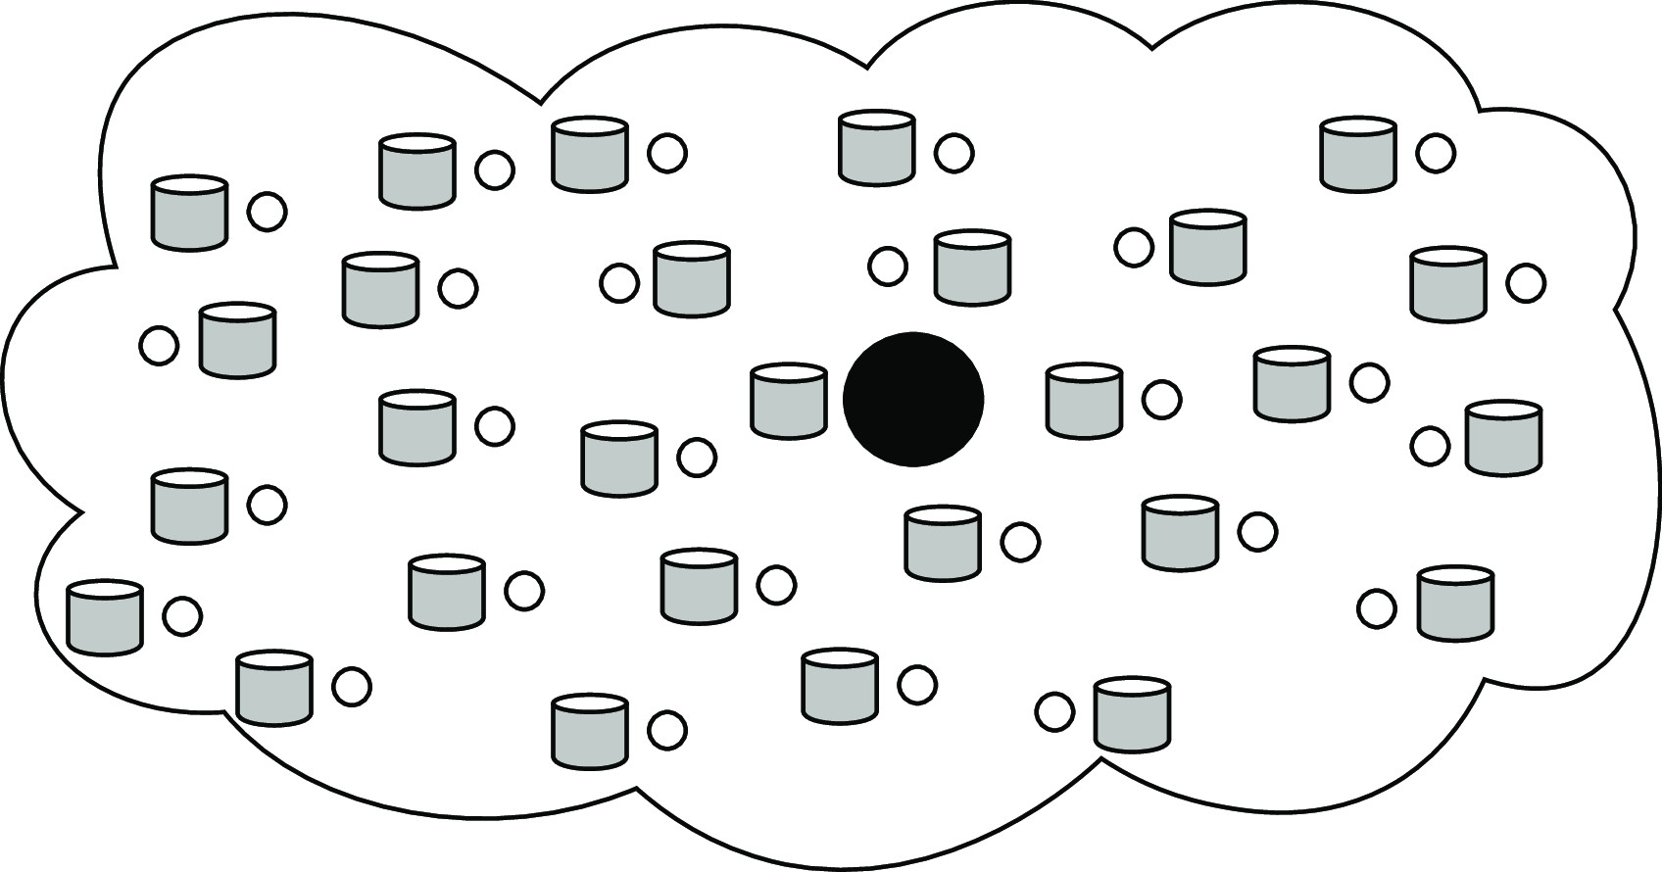
Architectures
Hybrid system architectures
Appending a block: distributed consensus
Centralized solution
Observation
A single entity decides on which validator can go ahead and append a block. Does not fit the design goals of blockchains.
Blockchain architectures

Slide 46
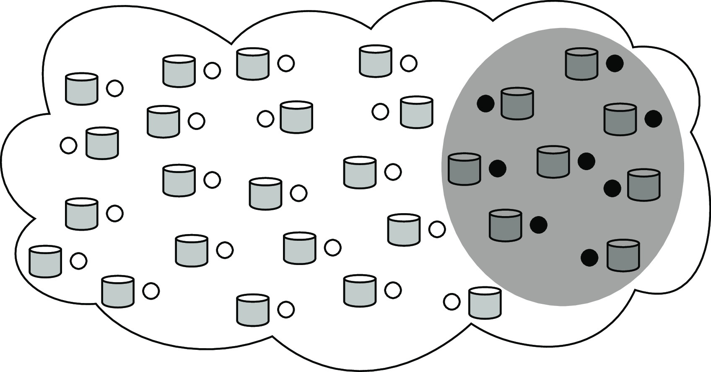
Architectures
Hybrid system architectures
Appending a block: distributed consensus
Distributed solution (permissioned)
Observation
A selected, relatively small group of servers jointly reach consensus on which validator can go ahead.
None of these servers needs to be trusted, as long as roughly two-thirds behave according to their specifications.
In practice, only a few tens of servers can be accommodated.
Blockchain architectures

Slide 47
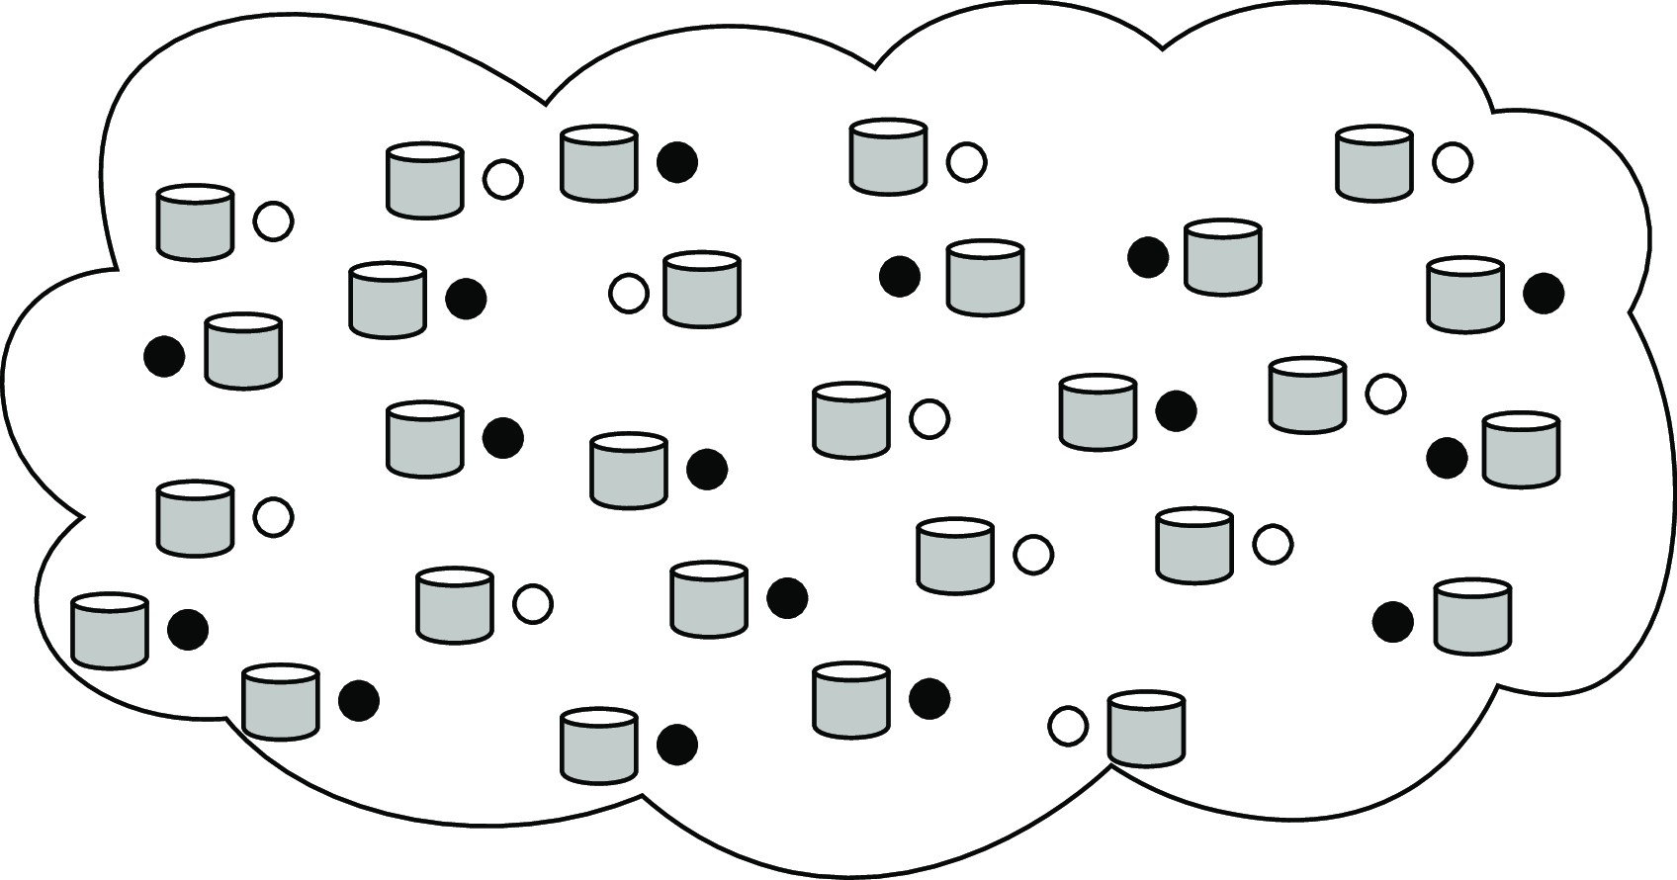
Architectures
Hybrid system architectures
Appending a block: distributed consensus
Decentralized solution (permisionless)
Observation
Participants collectively engage in a leader election. Only the elected leader is allowed to append a block of validated transactions.
Large-scale, decentralized leader election that is fair, robust, secure, and so on, is far from trivial.
Blockchain architectures

Slide 48
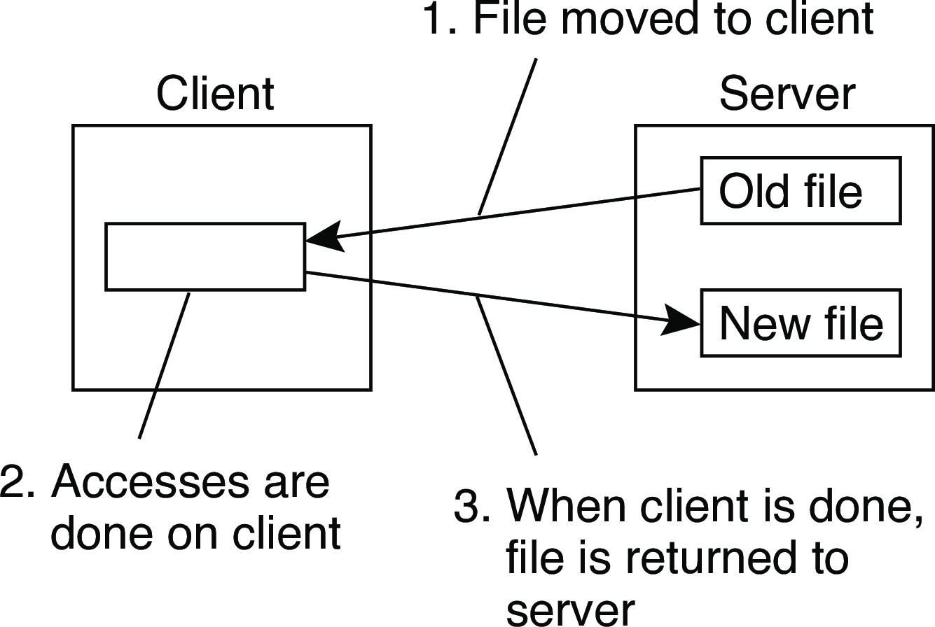
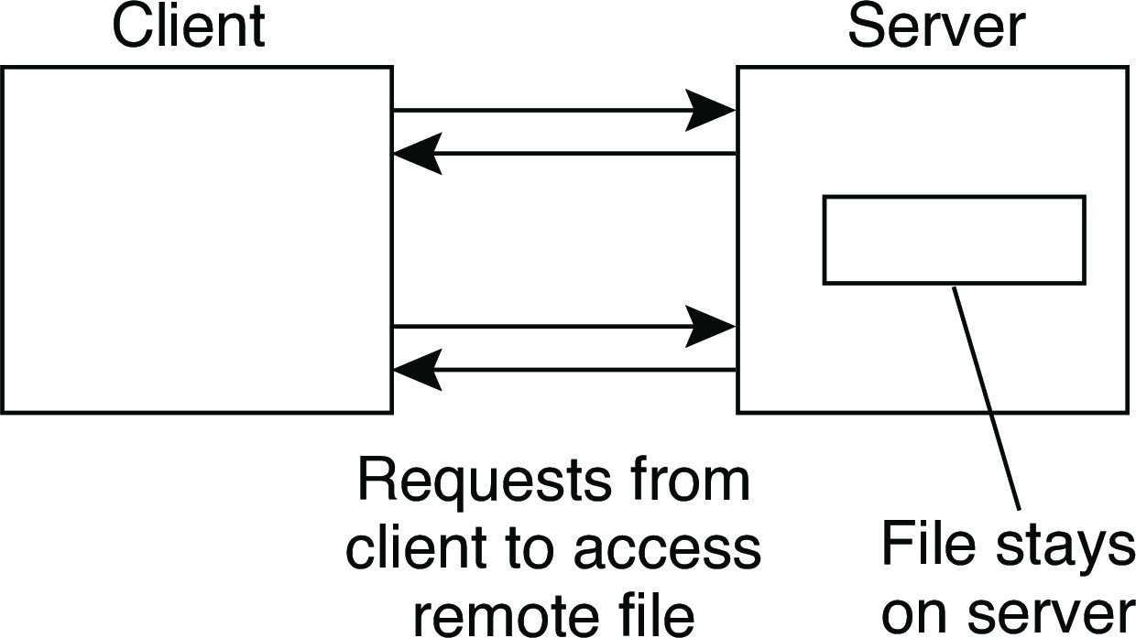
Example: The Network File System
Architectures Layered-system architectures
Foundations
Each NFS server provides a standardized view of its local file system: each server supports the same model, regardless the implementation of the file system.
The NFS remote access model
Remote access Upload/download
Note
FTP is a typical upload/download model. The same can be said for systems like Dropbox.
Example: The Network File System

Slide 49
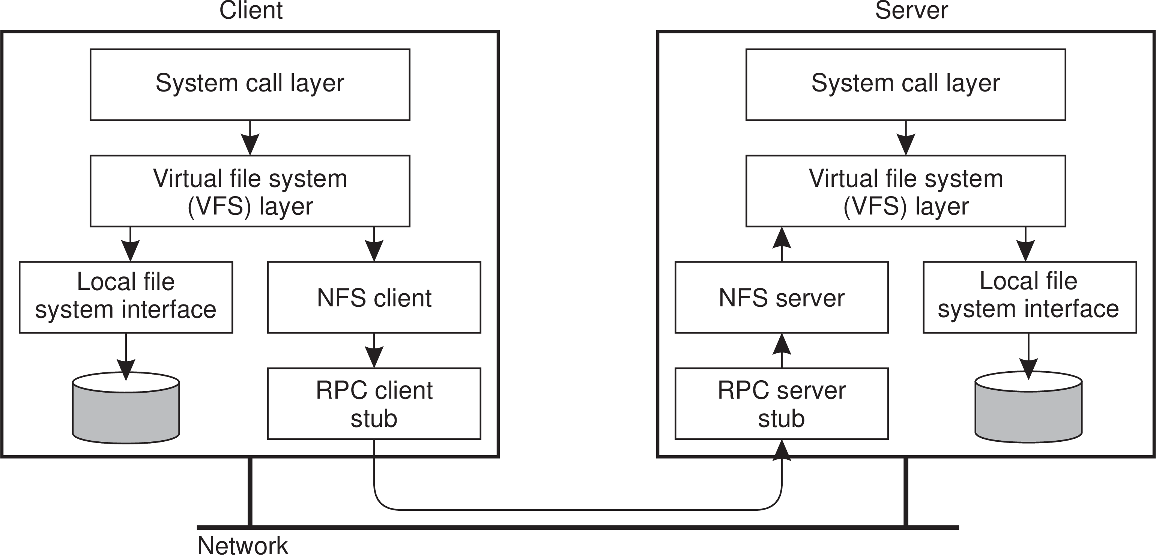
Architectures
Layered-system architectures
NFS architecture
Example: The Network File System

Slide 50
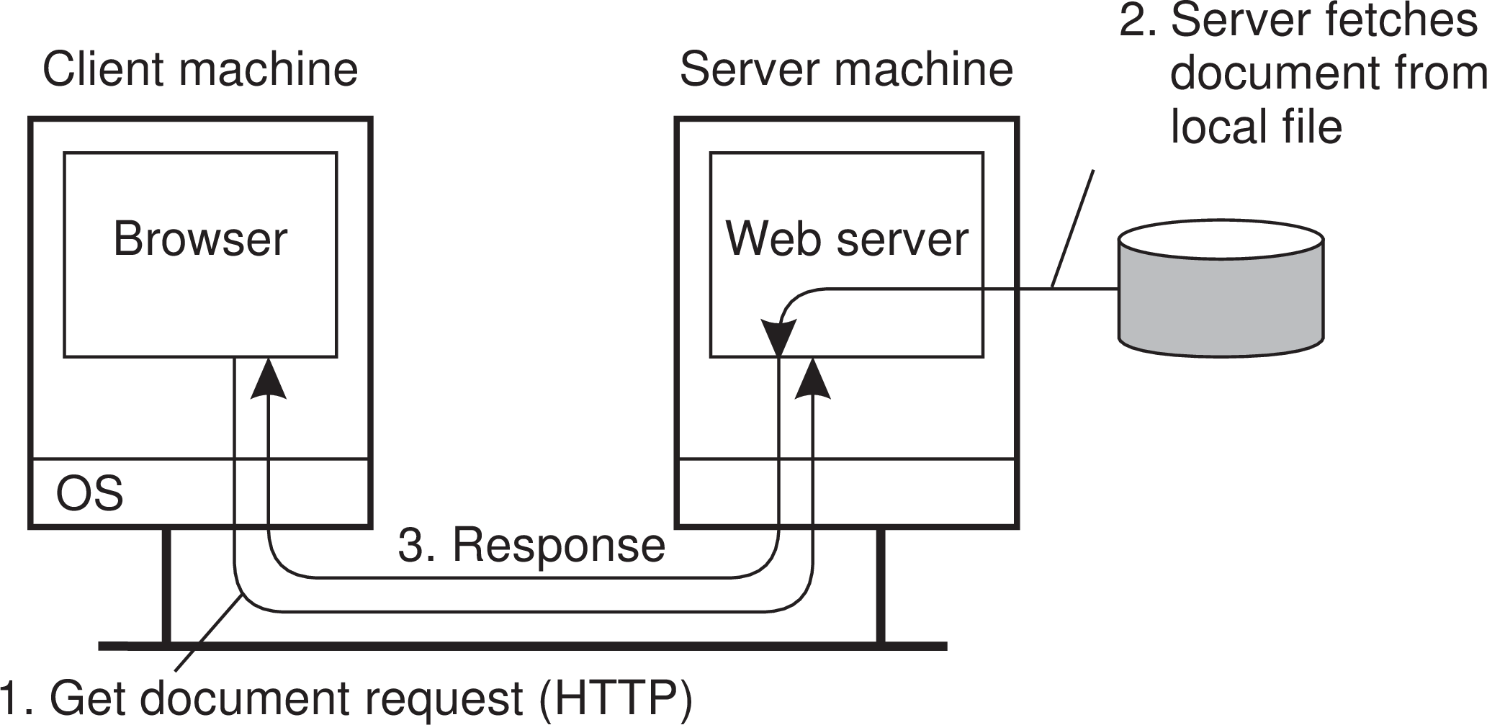
Architectures
Layered-system architectures
Example: Simple Web servers
Back in the old days...
...life was simple:
A website consisted as a collection of HTML files
HTML files could be referred to each other by a hyperlink
A Web server essentially needed only a hyperlink to fetch a file
•
A browser took care of properly rendering the content of a file
Example: The Web

Slide 51
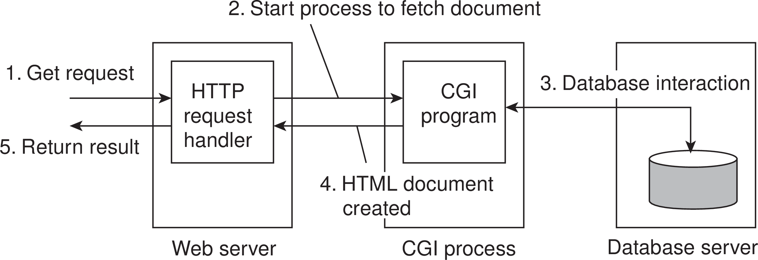
Architectures
Layered-system architectures
Example (cnt’d): Less simple Web servers
Still back in the old days...
...life became a bit more complicated:
A website was built around a database with content
A Webpage could still be referred to by a hyperlink
A Web server essentially needed only a hyperlink to fetch a file
A separate program (Common Gateway Interface) composed a page
•
A browser took care of properly rendering the content of a file
Example: The Web

Slide 52
Alternative organizations
Architectures Symmetrically distributed system architectures
Vertical distribution
Comes from dividing distributed applications into three logical layers, and running the components from each layer on a different server (machine).
Horizontal distribution
A client or server may be physically split up into logically equivalent parts, but each part is operating on its own share of the complete data set.
Peer-to-peer architectures
Processes are all equal: the functions that need to be carried out are represented by every process ⇒ each process will act as a client and a server at the same time (i.e., acting as a servant).

